Slide 1

Site RM
Doctor en ciencias veterinarias
Neida Chaves - Info IV 2019

Slide 2
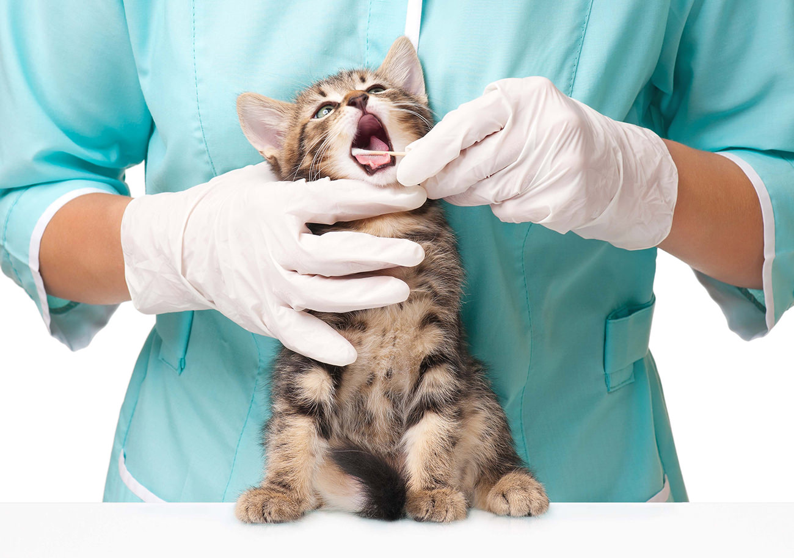
Doctor en ciencias veterinarias

Slide 3
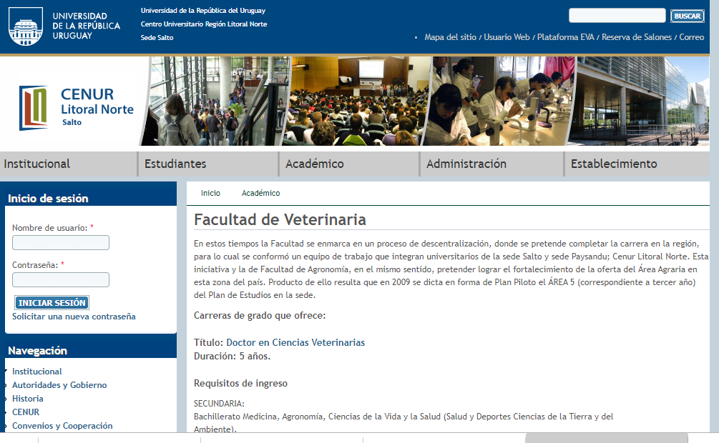
Links de referencias:
http://www.unorte.edu.uy/fvet

Slide 4
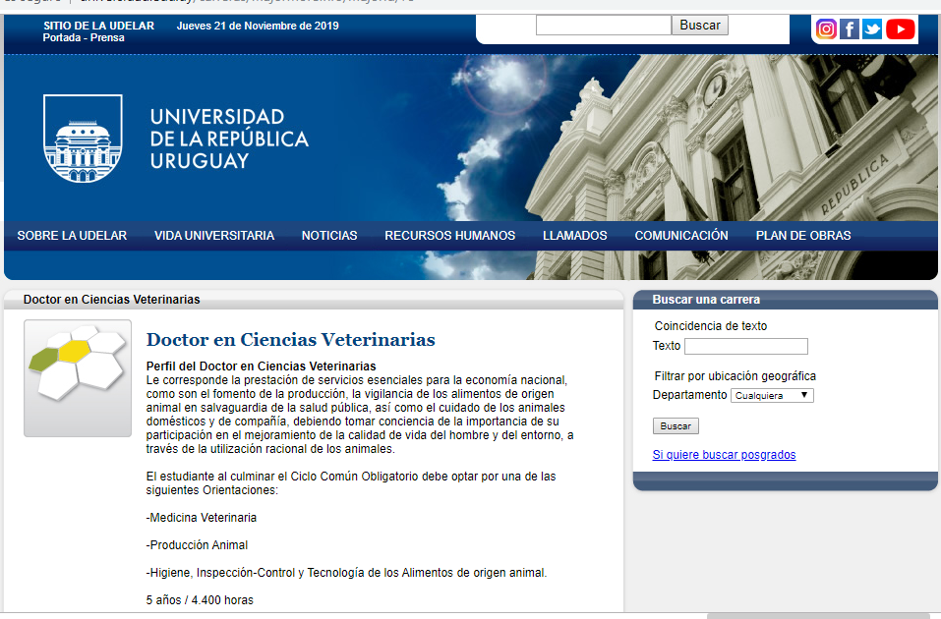
http://www.universidad.edu.uy/carreras/majorMoreInfo/majorId/75

Slide 5
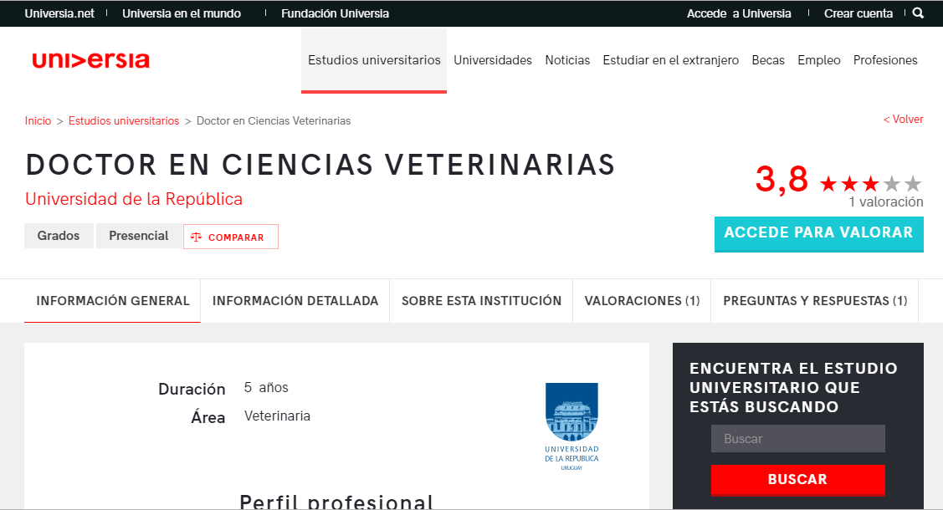
https://www.universia.edu.uy/estudios/universidad-republica/doctor-ciencias-veterinarias/st/159168#

Slide 6
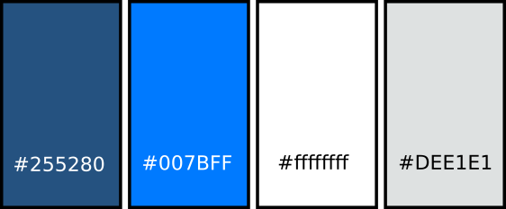
Paleta de colores:

Slide 7
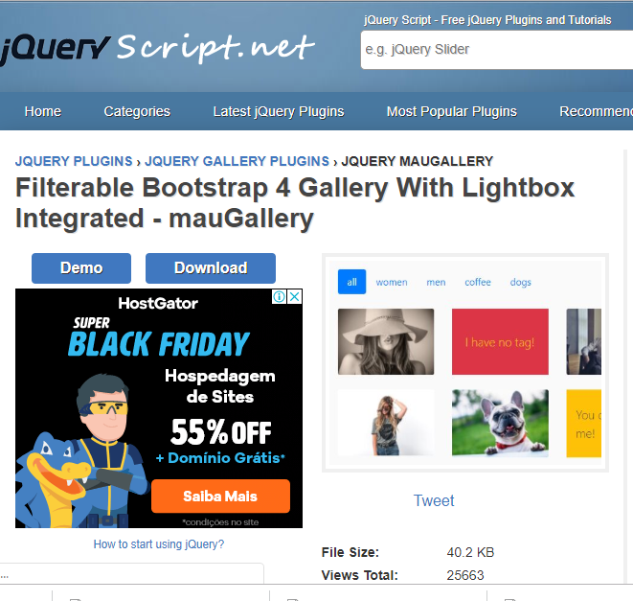
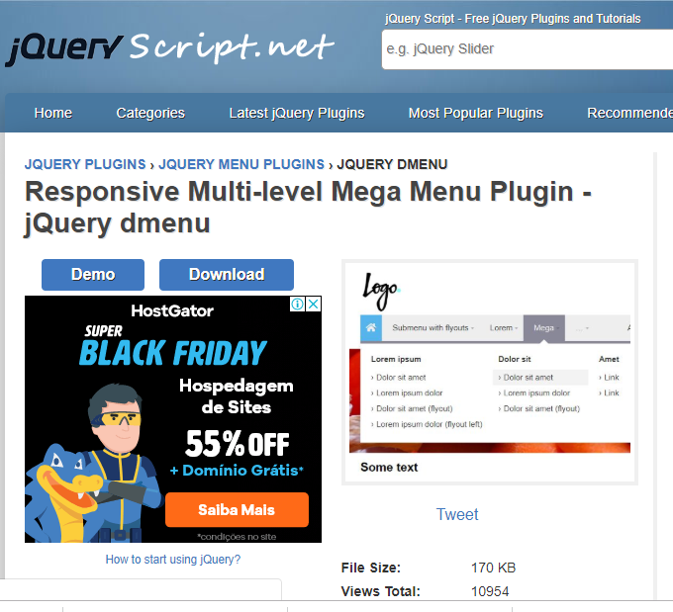
Plugins:
https://www.jqueryscript.net/gallery/Filterable-Bootstrap-Gallery-Lightbox-mauGallery.html
https://www.jqueryscript.net/menu/Responsive-Mega-Menu-dmenu.html

Slide 8
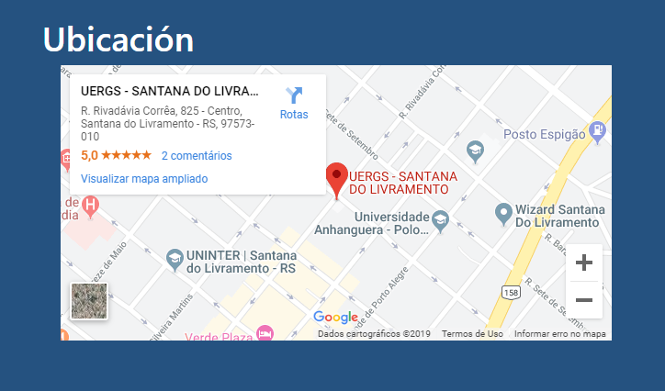
Iframe:
<iframe src="https://www.google.com/maps/embed?pb=!1m18!1m12!1m3!1d3423.8932776092747!2d-55.53466278469481!3d-30.88964637806163!2m3!1f0!2f0!3f0!3m2!1i1024!2i768!4f13.1!3m3!1m2!1s0x95a9fe56f2f02113%3A0x8ab11e859d8cb551!2sUERGS+-+SANTANA+DO+LIVRAMENTO!5e0!3m2!1spt-BR!2sbr!4v1566245825007!5m2!1spt-BR!2sbr" width="600" height="300" frameborder="0" style="border:0" allowfullscreen></iframe>

Slide 9
Referencias:
http://www.unorte.edu.uy/fvet
http://www.universidad.edu.uy/carreras/majorMoreInfo/majorId/75
https://www.universia.edu.uy/estudios/universidad-republica/doctor-ciencias-veterinarias/st/159168#
https://www.jqueryscript.net/gallery/Filterable-Bootstrap-Gallery-Lightbox-mauGallery.html
https://www.jqueryscript.net/menu/Responsive-Mega-Menu-dmenu.html

